Slide 1
Bayes net wrapup
Exact inference algorithms
Use to compute P(X₁, ..., X_{n}) or P(X₁, ..., X_{n} | E₁, ..., E_{m})
Approximate inference algorithms
Direct sampling
Rejection sampling
Likelihood weighting

Slide 2
Direct Sampling
To estimate P(X₁, ..., X_{n}), sample from the Bayes net and count how many samples match the query.
Divide by the total number of samples.

Slide 3
Rejection Sampling
We want to estimate P(X₁, ..., X_{n} | E₁, ..., E_{m}).
P(X₁, ..., X_{n} | E₁, ..., E_{m}) = P(X₁, ..., X_{n}, E₁, ..., E_{m}) / P(E₁, ..., E_{m})
To estimate this conditional probability, sample from the Bayes net and count how many samples match the numerator, divide by the number of samples that match the denominator.
Called rejection sampling because if the E variables are very restrictive, not many samples will match (we reject them).

Slide 4
Likelihood weighting
We want to estimate P(X₁, ..., X_{n} | E₁, ..., E_{m}).
We avoid generating samples that don’t fit the E variables.
Rejection sampling wastes time by throwing these out.
Instead, we directly generate samples that fit the E variables along with a corresponding weight.
After generating a bunch of samples, count them proportionally to the sum of their weights.

Slide 5
Likelihood weighting algorithm
I want to estimate P(X₁, ..., X_{n} | E₁, ..., E_{m}).
Generate a topological ordering of the BN vars.
set weight = 1
for each variable V in the Bayes net:
if V is an evidence variable with value v:
weight = weight * P(V = v | parents(V))
else:
sample from P(V | parents(V)) to get value of V.
return the weight and the sample of all variables.
To estimate probability, divide sum of weights that match X₁, ..., X_{n} by sum of all weights.

Slide 7
Statistical Inference

Slide 8
Toolbox so far
Uninformed search
BFS, DFS, Dijkstra’s algorithm (Uniform-cost search)
Heuristic search
A*, greedy best-first search
Probability and Bayes nets
Exact inference algorithm, approximate inference algorithms

Slide 9
Bayesian networks (Bayes nets)
Specify a full joint probability distribution.
Uses conditional and marginal independences to represent information compactly.
Example of a probabilistic model.
All probability questions have a unique right answer.
We can use the exact inference algorithm for Bayes nets to find it.

Slide 10
Real world
Real world situations are often missing a model (maybe we don't have all the information necessary to create a Bayes net).
We only have a small handful of observations about the world and we aren't entirely sure about how things relate to each other.
How can we make probability estimates now?

Slide 11
Statistical inference
Statistical inference lets us make probability estimations from observations about the way the world works, even if those observations don't tell the full story.
How likely is this email spam?
What is the probability it will rain tomorrow?
If I visit a certain house when trick-or-treating, what is the chance I'll get a Snickers bar?

Slide 12
Types of inference
Hypothesis testing:
Given two or more hypotheses (events), decide which one is more likely to be true based on some data.
Example: Is this email spam or not spam?
Parameter inference:
Given a model that is missing some probabilities, estimate those probabilities from data.
Example: Estimate bias of a coin from flips.

Slide 13
Hypothesis testing
Let D be the event that we have observed some data.
Ex: D = received an email containing "cash" and "viagra"
Sometimes D is also called evidence or observations.
Let H₁, …, H_{k} be disjoint, exhaustive events representing hypotheses to choose between.
Ex: H₁ = this email is spam, H₂ = it's not spam.
How do we use D to decide which H is most likely?

Slide 14
Maximum likelihood
Suppose we know or can estimate the probability P(D | H_{i}) for each H_{i}.
The maximum likelihood (ML) hypothesis is:
How to use it: compute P(D | H_{i}) for each hypothesis and select the one with the greatest value.
H^{ML} = maximum likelihood hypothesis
What is argmax? It means evaluate P(D|Hi) for all hypotheses Hi and take the *hypothesis* that maximizes P(D|Hi). This is not a number; this is a hypothesis (an event)!

Slide 15
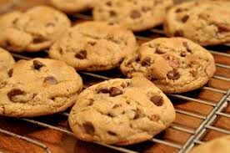
Professors Larkins and Sanders bake cookies for all of the CS students! Each professor keeps the cookies in their offices and the students can go pick one up.
Sanders has baked an equal number of both chocolate chip and oatmeal raisin cookies.
Larkins has baked chocolate chip and oatmeal raisin and as well, but twice as many oatmeal raisin as chocolate chip.
I ask my friend to get me a cookie. I know they will visit either Larkins or Sanders. My friend comes back with a chocolate chip cookie.
Is my cookie more likely to have been baked by Sanders or Larkins?
Notes:
identify hypotheses = L, S
identify data = receive choc chip cookie = C.
What is P(D |H i)? P(C|S) = ½, and P(C|L) = 1/3
H(ML) = Sanders.

Slide 16
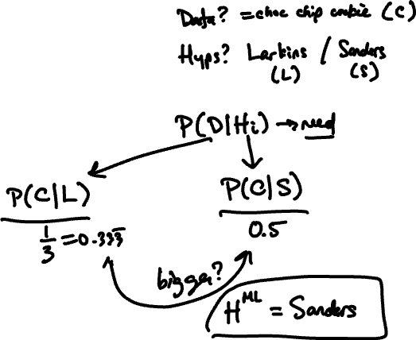
Sanders has baked an equal number of both chocolate chip and oatmeal raisin cookies.
Larkins has baked chocolate chip and oatmeal raisin and as well, but twice as many oatmeal raisin as chocolate chip.
I ask my friend to get me a cookie. I know they will visit either Larkins or Sanders. My friend comes back with a chocolate chip cookie.
Is my cookie more likely to have been baked by Sanders or Larkins?

Slide 17
I know that when my parents send me a check, there is an 98% chance that they will send it in a yellow envelope.
I also know that when my dentist sends me a bill, there is a 5% chance that they will send it in a yellow envelope.
Suppose a yellow envelope arrives on my doorstep.
What is the maximum likelihood hypothesis regarding the sender?

Slide 18
Why ML sometimes is bad
Suppose I tell you that there is a 3% chance that my any given envelope will be from my parents and a 97% chance that any given envelope will be from my dentist. Does it still seem likely that the envelope contains a check from my parents?

Slide 19
Bayesian reasoning
Rather than compute P(D | H_{i}), let's compute P(H_{i} | D).
What is the posterior probability of H_{i} given D?
Notes:
Prior probability = probability that something is true before you see any evidence one way or another (unconditional prob) P(Hi)
Posterior probability = probability that something is true after you see all the evidence. (conditional prob) P(Hi | D).

Slide 20
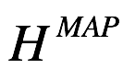
MAP hypothesis
Maximum a posteriori (MAP) hypothesis is the H_{i} that maximizes the posterior probability:

Slide 21
ML vs MAP
The MAP hypothesis takes the prior probability of each hypothesis into account, ML does not.

Slide 22
Professors Larkins and Sanders bake cookies for all of the CS students! Each professor keeps the cookies in their offices and the students can go pick one up.
Sanders has baked an equal number of both chocolate chip and oatmeal raisin cookies.
Larkins has baked chocolate chip and oatmeal raisin and as well, but twice as many oatmeal raisin as chocolate chip.
I ask my friend to get me a cookie. Suppose I know that my friend picks Larkins' cookies 90% of the time. My friend comes back with a chocolate chip one.
Is my cookie more likely to have been baked by Larkins or Sanders?
Notes:
identify hypotheses = L, S
identify data = receive choc chip cookie = C.
What is P(D |H i)? P(C|S) = ½, and P(C|L) = 1/3
P(S) = 0.1 P(L) = 0.9
Compare P(C|L)P(L) = (1/3)*0.9 = 0.3
P(C|S)P(S) = (1/2)*.1 = 0.05
H(MAP) = Larkins.

Slide 23
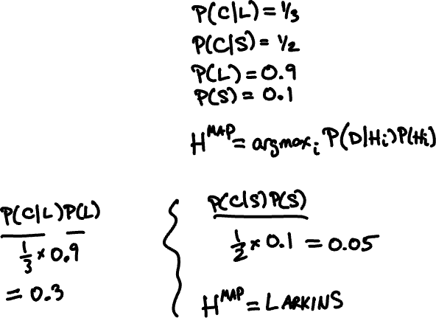
Sanders has baked an equal number of both chocolate chip and oatmeal raisin cookies.
Larkins has baked chocolate chip and oatmeal raisin and as well, but twice as many oatmeal raisin as chocolate chip.
I ask my friend to get me a cookie. Suppose I know that my friend picks Larkins' cookies 90% of the time. My friend comes back with a chocolate chip one.
Is my cookie more likely to have been baked by Larkins or Sanders?

Slide 24
I know that when my parents send me a check, there is an 98% chance that they will send it in a yellow envelope.
I know that when my dentist sends me a bill, there is a 5% chance that she will send it in a yellow envelope.
Unfortunately, I also know that there is a only a 3% chance that any given envelope will be from my parents, while there is a is a 97% chance that any given envelope will be from my dentist.
Suppose a yellow envelope arrives on my doorstep. What is the MAP hypothesis regarding the sender?

Slide 25
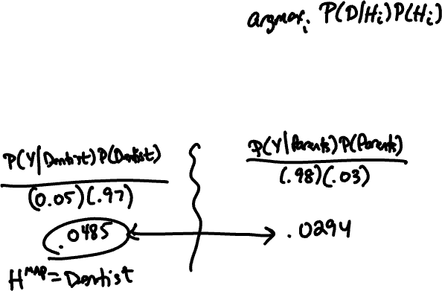
I know that when my parents send me a check, there is an 98% chance that they will send it in a yellow envelope.
I know that when my dentist sends me a bill, there is a 5% chance that she will send it in a yellow envelope.
Unfortunately, I also know that there is a only a 3% chance that any given envelope will be from my parents, while there is a is a 97% chance that any given envelope will be from my dentist.
Suppose a yellow envelope arrives on my doorstep. What is the MAP hypothesis regarding the sender?

Slide 26
There are 3 robots.
Robot 1 will hand you a snack drawn at random from 2 doughnuts and 7 carrots.
Robot 2 will hand you a snack drawn at random from 4 apples and 3 carrots.
Robot 3 will hand you a snack drawn at random from 7 burgers and 7 carrots.
Suppose your friend goes up to a robot (you don’t see this happen) and is given a carrot. Which robot did your friend probably approach?
What if the prior probability of your friend approaching robots 1, 2, and 3 are 20%, 40%, and 40%, respectively?

Slide 27
There are 3 robots.
Robot 1 will hand you a snack drawn at random from 2 doughnuts and 7 carrots.
Robot 2 will hand you a snack drawn at random from 4 apples and 3 carrots.
Robot 3 will hand you a snack drawn at random from 7 burgers and 7 carrots.
Suppose your friend goes up to a robot (you don’t see this happen) and is given a carrot. Which robot did your friend probably approach?
What if the prior probability of your friend approaching robots 1, 2, and 3 are 20%, 40%, and 40%, respectively?

Slide 28
ML vs MAP
When are the two hypothesis predictions the same?
Notes:
same when P(Hi) is equal for all Hi.

Slide 29
Probability vs hypothesis
Sometimes you only care about which hypothesis is more likely, and sometimes you need the actual probability.

Slide 30
In the robot problem, what is P(R3 | C)?

Slide 31
Probability vs hypothesis
In the robot problem, what is P(R3 | C)?
= (1/2 * 4/10) / (7/9 * 2/10 + 3/7 * 4/10 + 1/2 * 4/10) =~ 0.3795

Slide 32
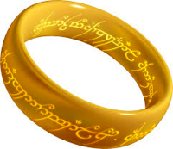
One slide to rule them all
The maximum likelihood hypothesis is the hypothesis that maximizes the probability of the observed data:
The MAP hypothesis is the hypothesis that maximizes the posterior probability given D:
P(H_{i}) is called the prior probability (or just prior).
P(H_{i}|D) is called the posterior probability.

Slide 33
There are 3 robots.
Robot 1 will hand you a snack drawn at random from 2 doughnuts and 7 carrots.
Robot 2 will hand you a snack drawn at random from 4 apples and 3 carrots.
Robot 3 will hand you a snack drawn at random from 7 burgers and 7 carrots.
Suppose your friend goes up to a robot (you don’t see this happen) and is given a carrot. Which robot did your friend probably approach?
What if the prior probability of your friend approaching robots 1, 2, and 3 are 20%, 40%, and 40%, respectively?

Slide 34
Probability vs hypothesis
Sometimes you only care about which hypothesis is more likely, and sometimes you need the actual probability.

Slide 35
In the robot problem, what is P(R3 | C)?

Slide 36
Probability vs hypothesis
In the robot problem, what is P(R3 | C)?
= (7/9 * 2/10) / (7/9 * 2/10 + 3/7 * 4/10 + 1/2 * 4/10) ~= 0.3795

Slide 37
Posterior probability
If you need the actual posterior probability:

Slide 38
A patient comes to visit Dr. Gregory House because they have a cough. After insulting and belittling the patient, House consults with his team of diagnosticians, who tell him that if a patient has a cold, then there’s a 75% chance they will have a cough. But if a patient has the Ebola virus, there’s a 80% chance they will have a cough.
What is the maximum likelihood hypothesis for the diagnosis?

Slide 39
A patient comes to visit Dr. Gregory House because they have a cough. After insulting and belittling the patient, House consults with his team of diagnosticians, who tell him that if a patient has a cold, then there’s a 75% chance they will have a cough. But if a patient has the Ebola virus, there’s a 80% chance they will have a cough.
What is the maximum likelihood hypothesis for the diagnosis?

Slide 40
After concluding the patient has Ebola, House fires all his diagnosticians for their poor hypothesis testing skills and hires new ones. This new team does some background research and discovers if they are only going to consider the common cold and Ebola, then before the symptoms are even considered, there’s a 1% chance the patient has Ebola and a 99% chance they have a cold.
What is the MAP hypothesis for the diagnosis? What is the posterior probability the patient has Ebola?

Slide 41
Suppose I work in FJ in a windowless office. I want to know whether it's raining outside. The chance of rain is 70%. My colleague walks in wearing his raincoat. If it’s raining, there’s a 65% chance he’ll be wearing a raincoat. Since he’s very unfashionable, there’s a 45% chance he’ll be wearing his raincoat even if it’s not raining. My other colleague walks in with wet hair. When it’s raining there’s a 90% chance her hair will be wet. However, since she sometimes goes to the gym before work, there’s a 40% chance her hair will be wet even if it’s not raining.
What’s the posterior probability that it’s raining?

Slide 42
Suppose I work in FJ in a windowless office. I want to know whether it's raining outside. The chance of rain is 70%. My colleague walks in wearing his raincoat. If it’s raining, there’s a 65% chance he’ll be wearing a raincoat. Since he’s very unfashionable, there’s a 45% chance he’ll be wearing his raincoat even if it’s not raining. My other colleague walks in with wet hair. When it’s raining there’s a 90% chance her hair will be wet. However, since she sometimes goes to the gym before work, there’s a 40% chance her hair will be wet even if it’s not raining.
What’s the posterior probability that it’s raining?

Slide 43
We can't solve this problem because we don’t have any information about the probability of Colleague 1 wearing a raincoat and Colleague 2 having wet hair occurring simultaneously.
We don't know P(C, W | R).
Let's make an assumption that C and W are conditionally independent given that it is raining (or not raining).
P(C, W | R) = P(C | R) * P(W | R)
(and similarly for given ~R)

Slide 44
Combining evidence
It is very common to make this independence assumption for multiple pieces of evidence (data).
where
Notes:
P(D_1\ldots, D_m) = \sum_{i=1}^k \Big(\prod_{j=1}^m P(D_j\mid H_i)\Big)P(H_i)

